Slide 1
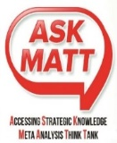

"NOT A CRIME" PROJECT IN LITTLETON - possibly cluster 18
This is a slide presentation of the result of the first meeting that the Local Spiritual Assembly (LSA) of Littleton held on November 21st of 2015 in order to create a Strategic Plan for a Baha‘i Project called : NOT A CRIME.. In this meeting we use a new method called ASK-MATT Game.
The purpose of the project is to help promoting a worldwide awareness and to support the idea that a formal college education is a basic human right of an individual, not only fostering a person‘s life sustenance, but it is also essential for the physical, intellectual, emotional and spiritual development of that individual. This essential human right is presently denied to Baha‘is in Iran since 1980s and the respective providers of higher education to Baha‘is are being persecuted. The project attempts to bring an awareness for this human right and to gain worldwide support by involving artists, leaders and community members to express peacefully this belief.
Participants: Kari Marshall, Shah Pezeshk, Marti Bitts, Bud Polk and Behrooz Behboodi. We also have an on-line Skype participation of the hounered guest and facilitator, Dr. Steven Wallis who is the founder of ASK-MATT

Slide 2
"NOT A CRIME" PROJECT IN LITTLETON - possibly cluster 18
A “Point Of Interest”(POI) – is like a place on a map. Players chooses what their POI will be and writes a title on the piece. Instead of “national parks” this can be anything that the player feels is important or interesting for the organization – from “pencils in the stockroom,” to “employee motivation,” and even “interest rate.” POIs should be measurable – but it is not absolutely essential. After all, there are some very important things in life that are very difficult to quantify.
A “Causeway” is like a road on a map. Only here, Causeways show the direction of cause-and-effect. For example, one POI might say, “providing more customer service training for employees” and a Causeway is played to link the training with another POI “customers more satisfied.” Essentially, the causeway tells how changes in on POI results in changes in another POI. A good way to evaluate a Causeway is to listen to how it sounds in a sentence. For example, “More of (this POI) will cause more of (that POI).” Negative expressions are not allowed. It is silly to say “This does NOT cause that” or “You can’t get there from here.”
Initials: MB Measures: hours looking for artists
LOCATE PUBLIC ARTISTS

Slide 3

"NOT A CRIME" PROJECT IN LITTLETON - possibly cluster 18
A “Fog” is placed when the group cannot come to a fast voting decision. Fog indicates lack of group clarity and the need for additional research. A Fog is placed if there is no majority for a vote on the measurability of a POI or the validity of a Causeway… or by group majority if the argument gets too heated (we’ve all been on road trips like that). When this occurs, discussion on the piece is halted for the time and play continues to the next person. A Causeway that is under FOG may remain on the map but does not count toward any player’s point total. A POI under FOG may remain on the table but the player does not receive a bonus point for measurability.
BONUS - A Gold Star is placed on a POI the first time that a second valid Causeway is placed pointing towards the POI (a valid Causeway is one that passes the vote). The player who places that Causeway is awarded a bonus point. On a real map, different roads provide you with different options for reaching your destinations. The Gold Star shows the importance of having different paths to reach your POIs. MORE POIs with Gold Stars means a higher Group score.

Slide 4
"NOT A CRIME" PROJECT IN LITTLETON - possibly cluster 18
TO GAIN a higher score, be sure that the POIs you play are measurable. Some things (morale, for example) are important, but not easily measurable. Be sure that the Causeways you play are reasonable! Finally, aim to be the person who places the second Causeway pointing toward a POI.
MISCELLANEOUS RULES
Pieces may be rearranged by group consensus – especially to make the map more readable and/or to make room for more pieces.
A “FOG” piece may be placed by any person as a reminder to indicate where additional conversation or research is needed “outside the room.” No adjustment to score occurs when a Fog is placed by an individual.
Rules may be changed with consent of facilitator and consensus of all players. All

Slide 5
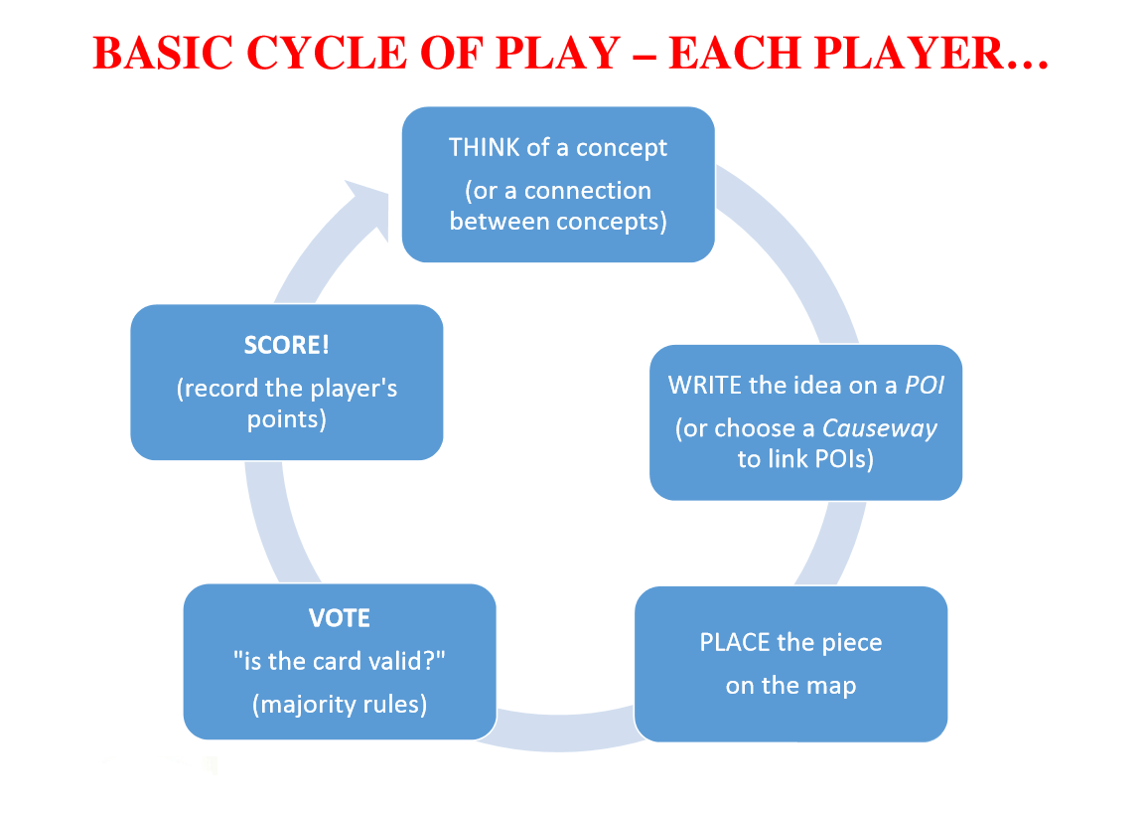
"NOT A CRIME" PROJECT IN LITTLETON - possibly cluster 18

Slide 6

"NOT A CRIME" PROJECT IN LITTLETON - possibly cluster 18
Initials: MB
Measures: hours looking for artists
LOCATE PUBLIC ARTISTS
Initials:
Measures: Showing Support
DETERMINE A GROUP INTERESTED IN EDUCATION
Initials: BP
Measures: Number of localities
FINDING LOCALITIES FOR THE ART TO BE SHOWN
Contacting
Narrowing down
Initials:
Measures:
FUNDS AVAILABLE!
Initials: BP
Measures: No. of cummunities who participate the planning meetings
INVOLVE OTHER BAHA'I COMMUNITIES
Initials: BP
Measures: Consensus of LSA
DEVELOP ARTIST GUIDELINE
Initials: SP
Measures: Postes and likes
INVOLVING SOCIAL MEDIA
Initials:
Measures: Dollars Raised
FUND-RAISING
Initials: BP
Measures:
IDENTIFY PROJECT COORDINATOR
Initials:SP
Measures:
INVOLVE LOCAL AND REGIONAL OFFICIALS
Initials:
Measures:
EDUCATION IS A RIGHT,
NOT A CRIME!

